Slide 1
Advanced analysis of algorithms cs-611 - first homework
Rahaf alalyani
2100477

Slide 2

OUTLINE
What is pattern searching algorithm ?
Importance/applications of pattern searching
Types of pattern searching algorithms
Gear used for the comparing algorithms program
What I have learned
References

Slide 3
What is pattern/string search algorithm
The most basic case of string searching involves one (often very long) string, sometimes called the haystack, and one (often very short) string, sometimes called the needle. The goal is to find one or more occurrences of the needle within the haystack.
For example, one might search for to within:
*One might request the first occurrence of "to", which is the fourth word; or all occurrences, of which there are 3; or the last, which is the fifth word from the end.

Slide 4
Importance/applications of pattern searching
Spell Checkers
Spam Filters
Intrusion Detection System
Search Engines
Plagiarism Detection
Bioinformatics
Digital Forensics and Information Retrieval Systems

Slide 5
Types of pattern searching algorithms
1-naïve/Basic / Brute Force search:

Slide 6
Types of pattern searching algorithms
2- Knuth–Morris–Pratt algorithm

Slide 7
Types of pattern searching algorithms
3- Boyer–Moore string-search algorithm

Slide 8
Types of pattern searching algorithms
4- Rabin–Karp algorithm

Slide 9
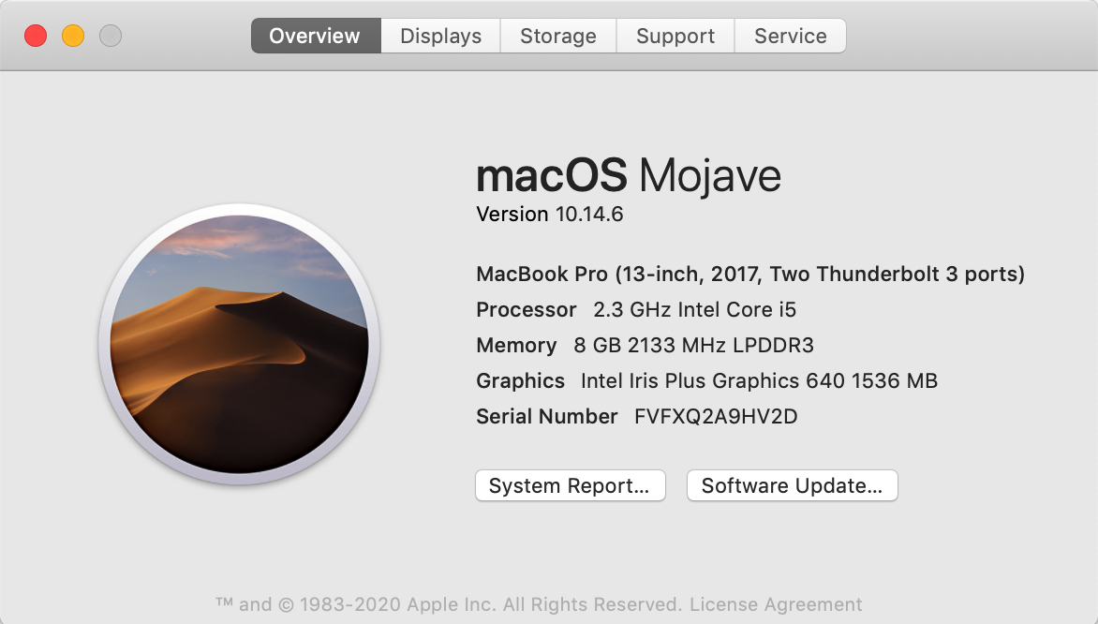
gear used :

Slide 10
What I have learned
1- I learned more about searching algorithms and how they work
2-improved my programming skills
3-improved my researching skills

Slide 11
References
https://www.wikipedia.org
https://www.geeksforgeeks.org
http://whocouldthat.be/visualizing-string-matching/
https://www.codota.com/code/java/classes/javax.swing.text.Highlighter
https://www.youtube.com/watch?v=2gbEAE5Puag
https://www.youtube.com/watch?v=TMngu90cnNQ&t=137s

Slide 12

Thank you so much

